Slide 1

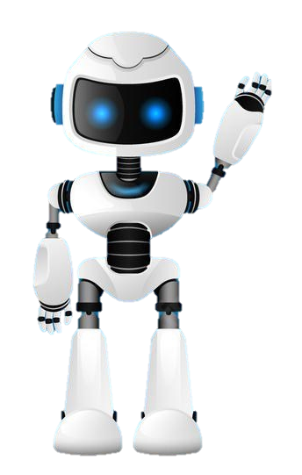
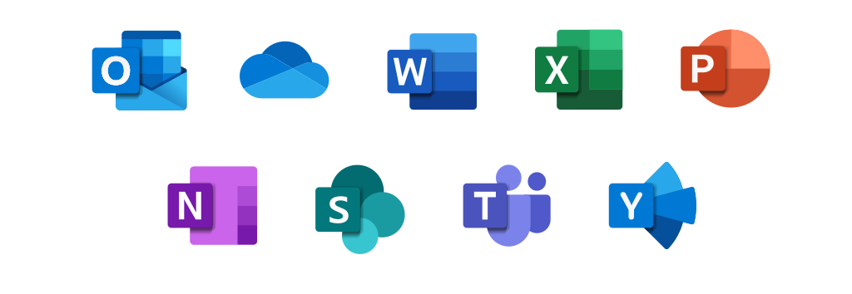
Learning Journal
Unit 1:E-Skills

Slide 2

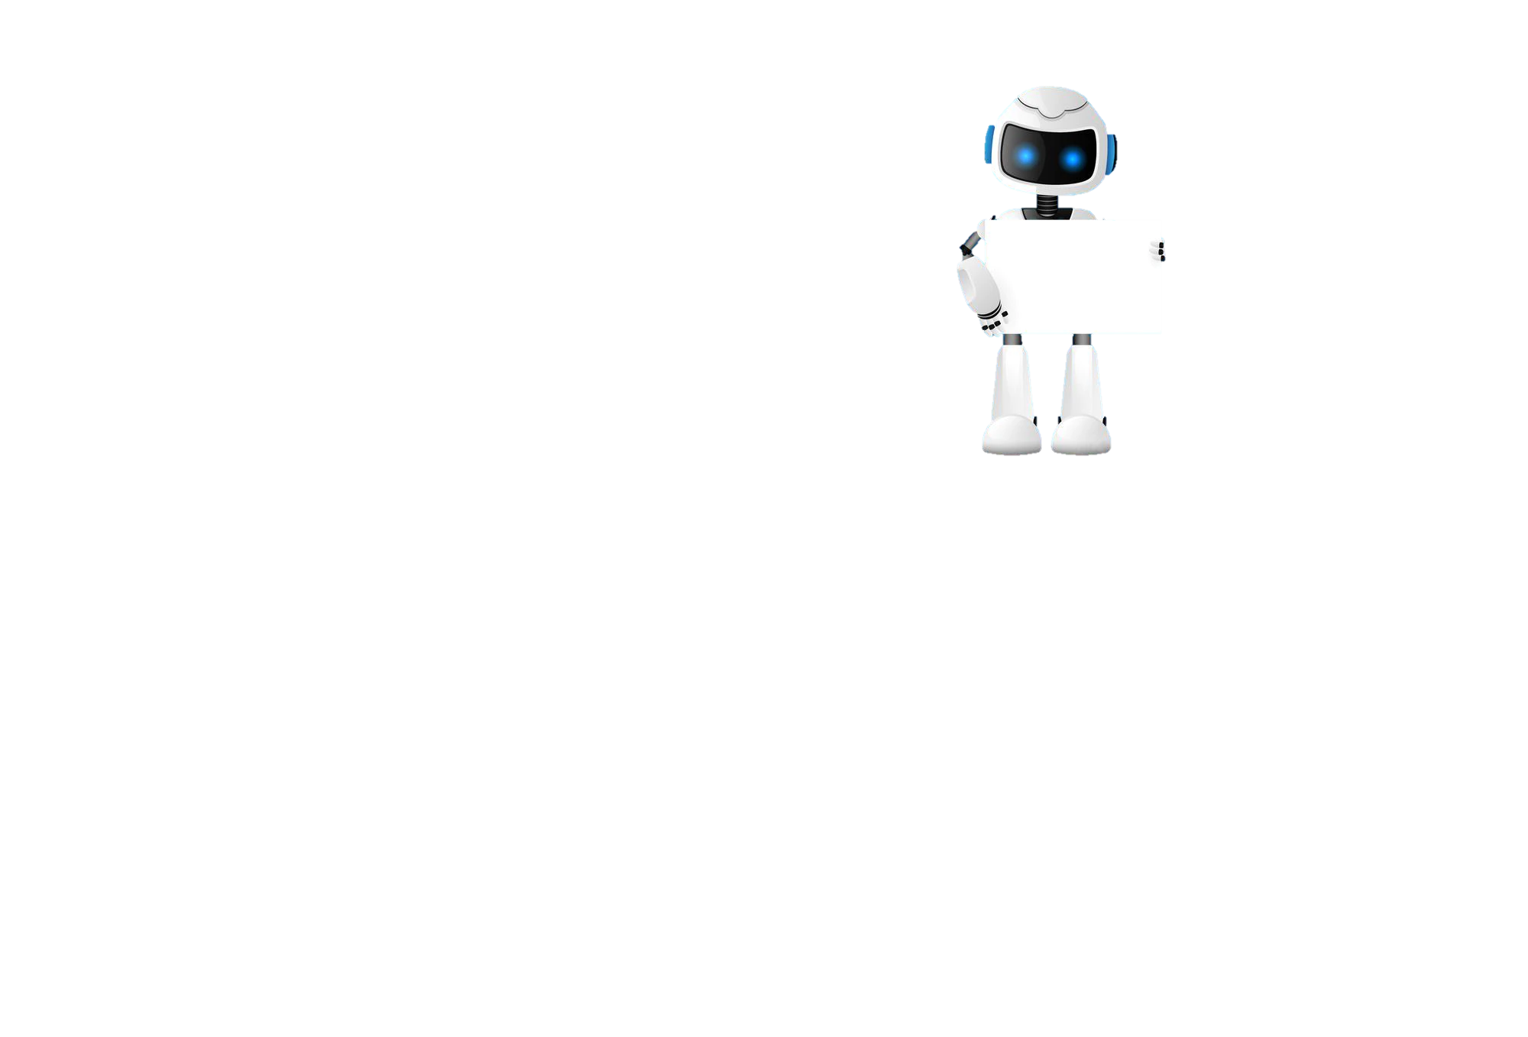

Lesson 1
Task 1 – Getting Started
Learning Objectives
Start
I can use file explorer to access my home Drive
I can create, rename and organise folders
File Explorer
In your own words write down what file explorer helps you to do on a computer.
Learn

Slide 3
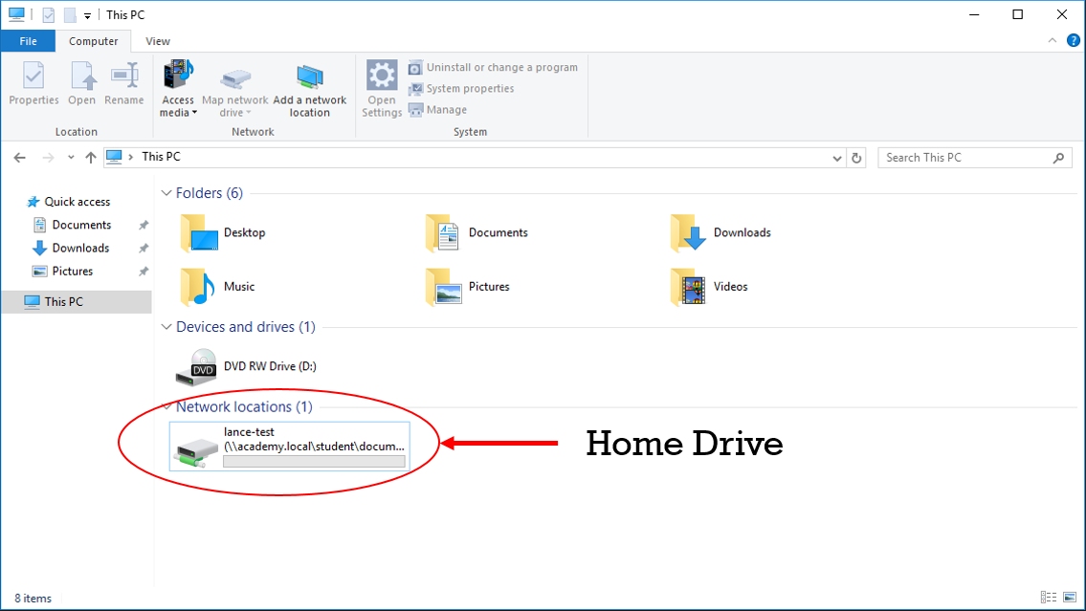
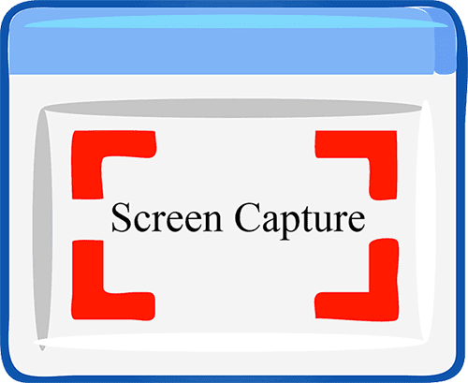
I can use file explorer to get to my home Drive
Lesson 1
Task 2 – Using File Explorer
Put a screen capture of your home drive inside this box.

Slide 4
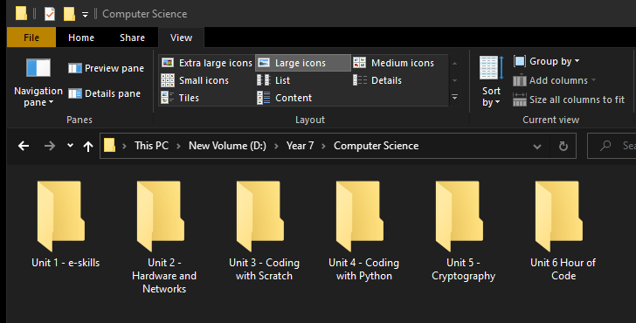
I can create and organise folders using file explorer
Lesson 1
Task 4 – Creating Folders
Put a screen capture of your folders inside this box

Slide 5

Lesson 1
Task 5 – Lesson review
Learning Objectives
Complete
How did you do?
Select the appropriate circle. Then go to shape format in the menu and colour it in.
I can use file explorer to access my home Drive
I can create, rename and organise folders.
Reflect
Write what you have learned today in the box below and anything you are still unsure of.

Slide 6
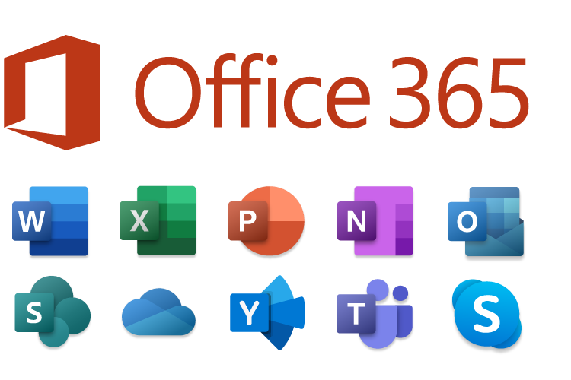
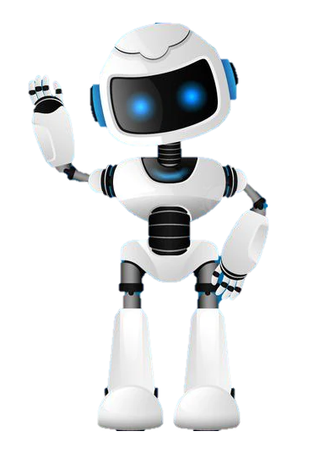
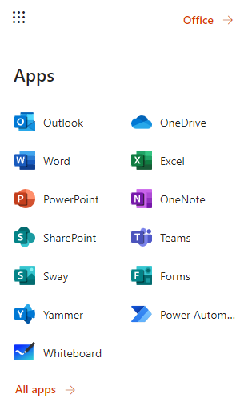
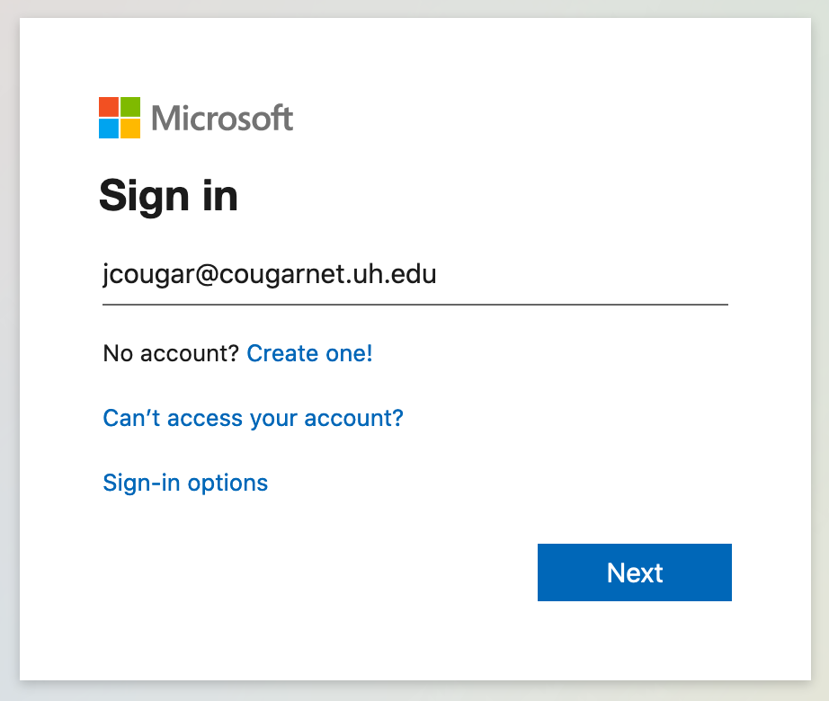
Homework
Task 6 – Homework
username@knoleacademy.org

