Slide 1

Data Representation
Put your name here
Computer Science

Slide 2
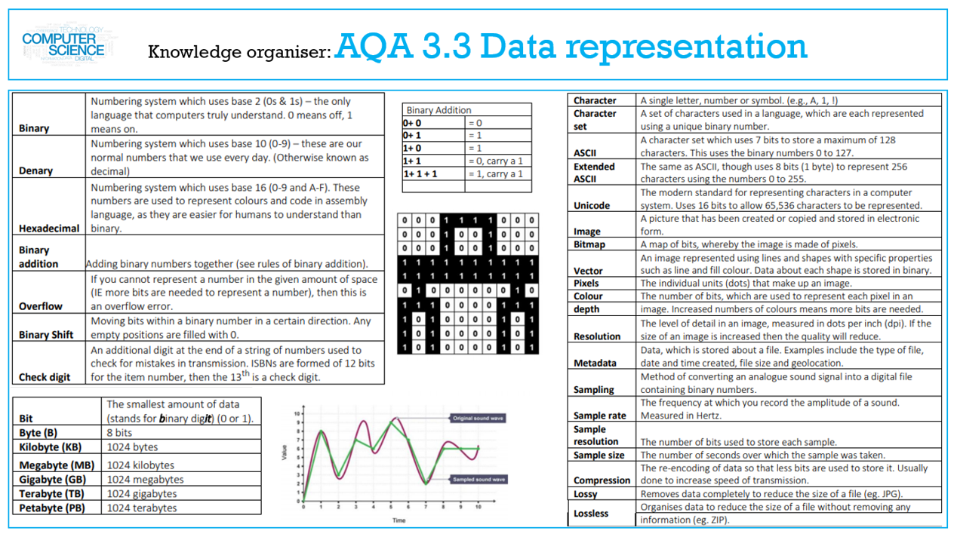

Slide 3
Lesson 1
Number Bases

Slide 4
My Screenshot

Slide 5
Lesson 2
Put lesson Name here
Put a description of the lesson here.

Slide 6
My Screenshot

Slide 7
Lesson 3
Put lesson Name here
Put a description of the lesson here.

Slide 8
My Screenshot

Slide 9
Lesson 4
Put lesson Name here
Put a description of the lesson here.

Slide 10
My Screenshot

Slide 11
Lesson 5
Put lesson Name here
Put a description of the lesson here.

Slide 12
My Screenshot

