Slide 1

Data Representation
Put your name here
Computer Science

Slide 2
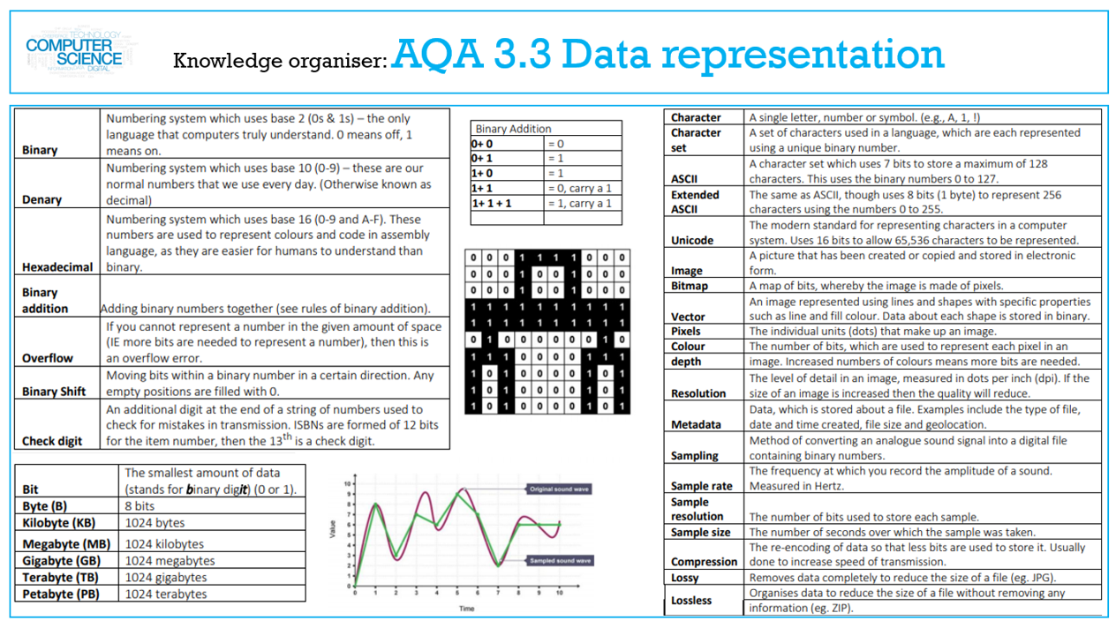

Slide 3
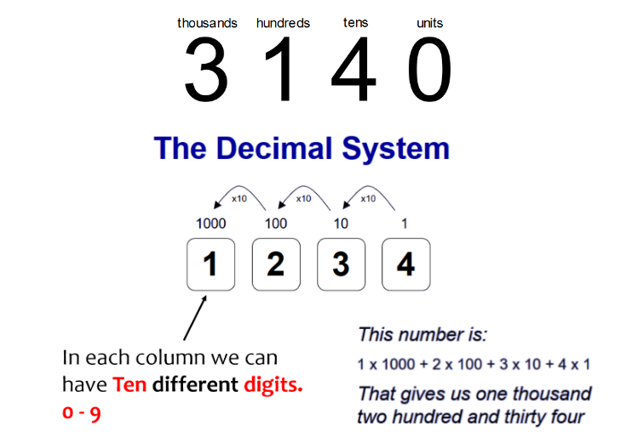
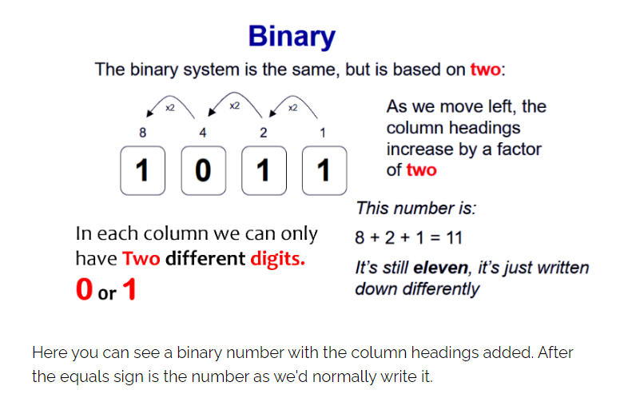
Lesson 1
Number Bases
I need to learn how to understand decimal (base 10)
I need to learn how to understand binary (base 2)
I need to learn how to understand that computers use binary to represent all data and instructions.
I need to learn how to understand how binary can be used to represent whole numbers.

Slide 4
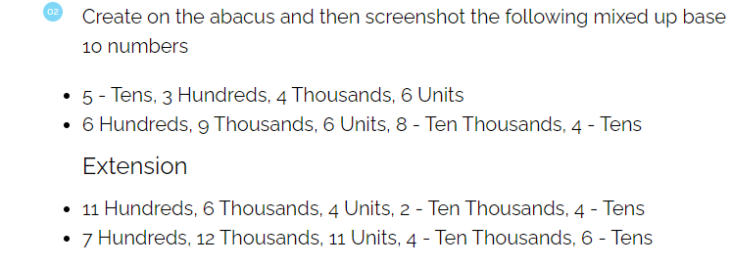
Screenshot your answers Below

Slide 5
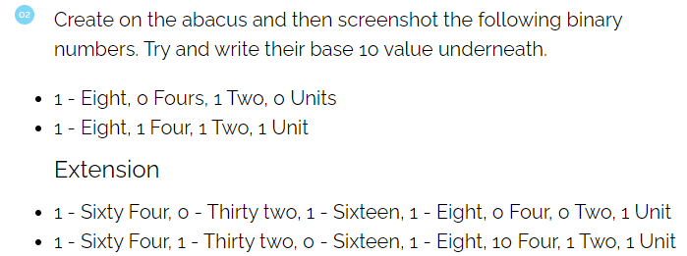
Screenshot your answers Below

Slide 6
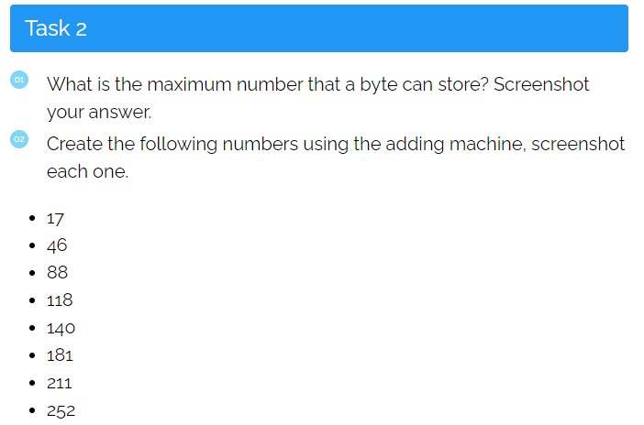
Screenshot your answers Below

Slide 7
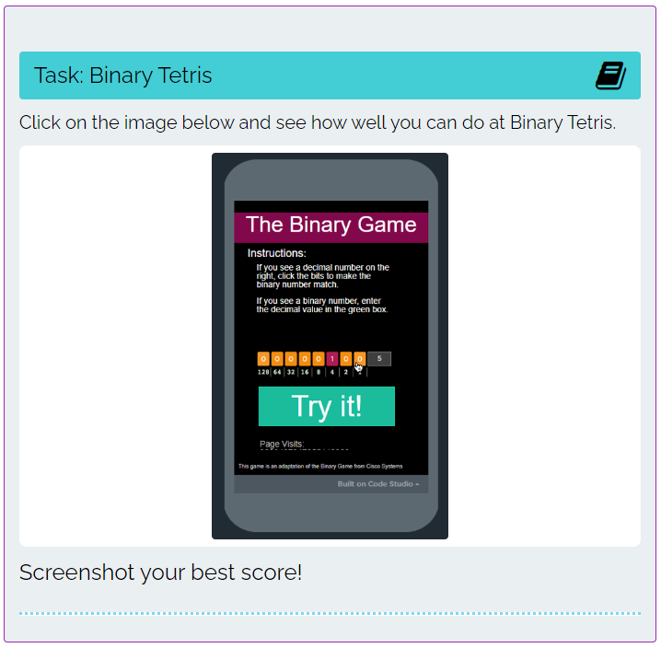
Screenshot your high score Below

Slide 8
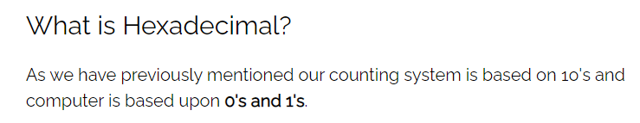
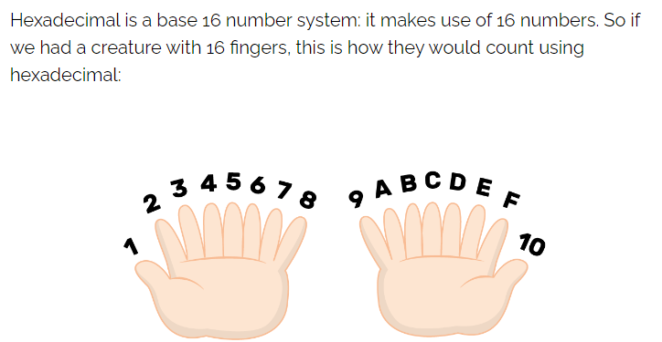
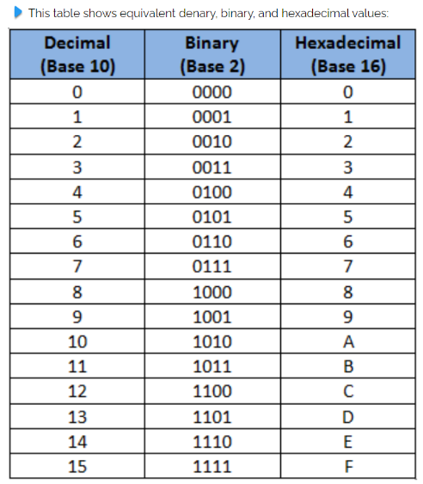
Lesson 2
Number Bases Hex
I need to learn how to understand how hexadecimal can be used to represent whole numbers.
I need to learn how to convert in both directions between binary and hexadecimal.

Slide 9
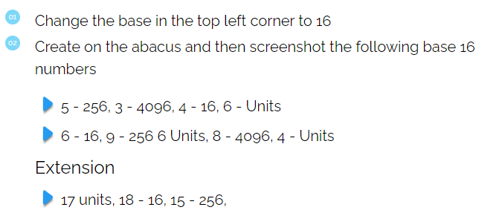
Screenshot your answers Below

Slide 10

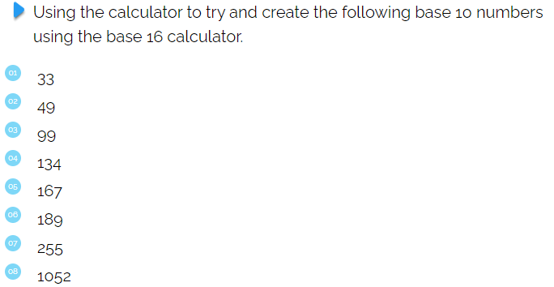
Screenshot your answers Below

Slide 11
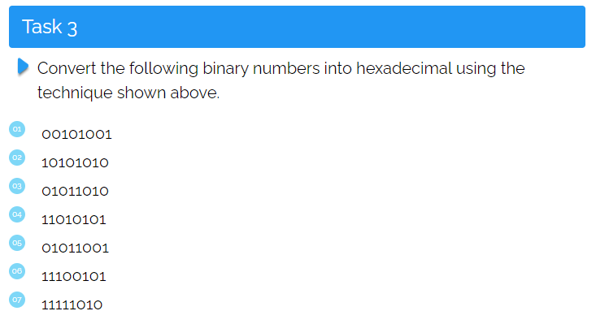
Write your answers Below

Slide 12
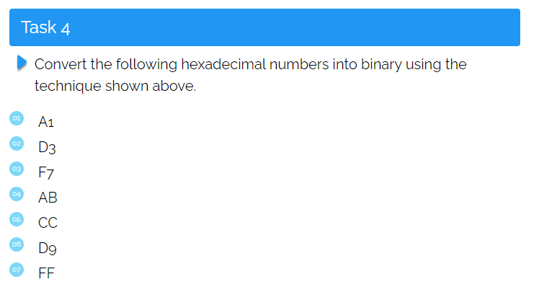
Write your answers Below

Slide 13
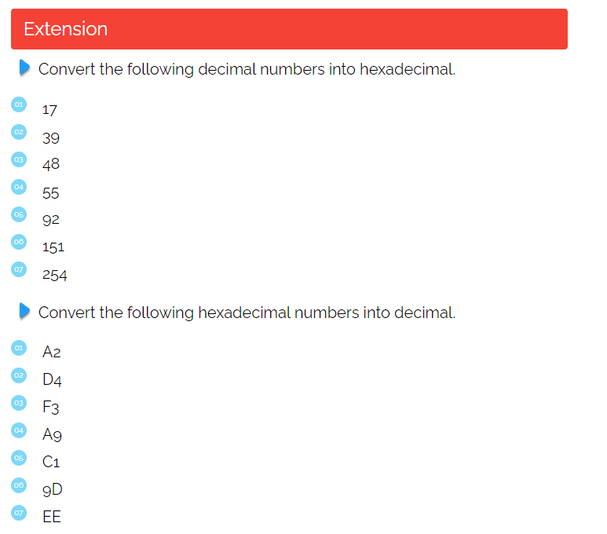
Write your answers Below

Slide 14
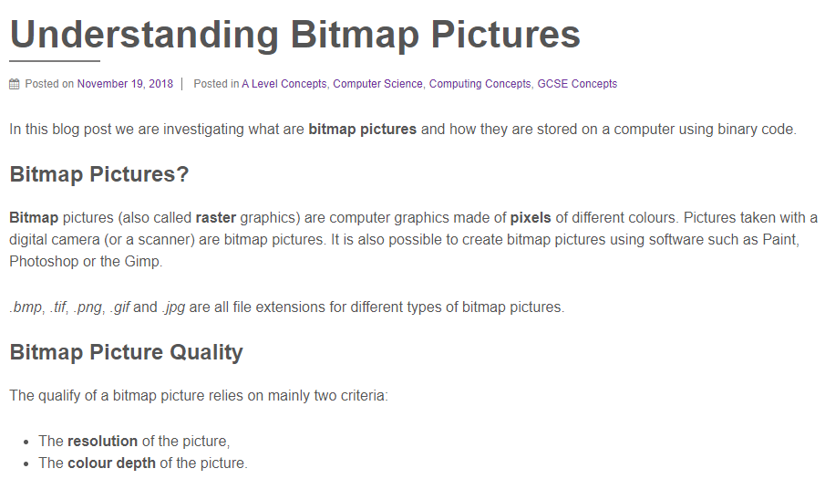
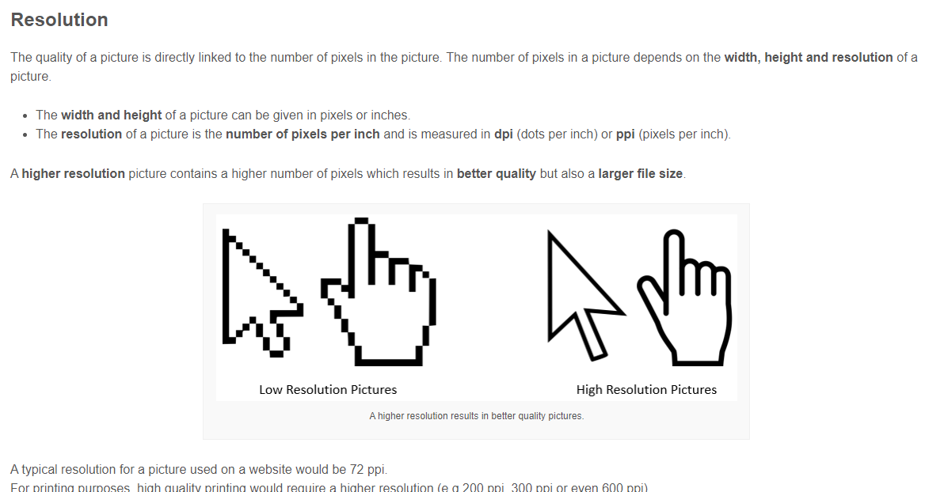
Lesson 3
Computer Graphics
I can explain what a pixel is and how pixels relate to an image and the way images are displayed.
I can describe how the size of a bitmap image in pixels (width x height) is known as the image resolution.
I can explain how the number of pixels and colour depth can affect the file size of a bitmap image.

Slide 15
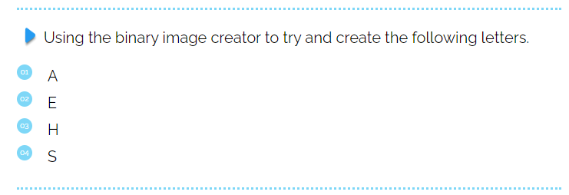
Screenshot your answers Below

Slide 16


Screenshot your image Below

Slide 17
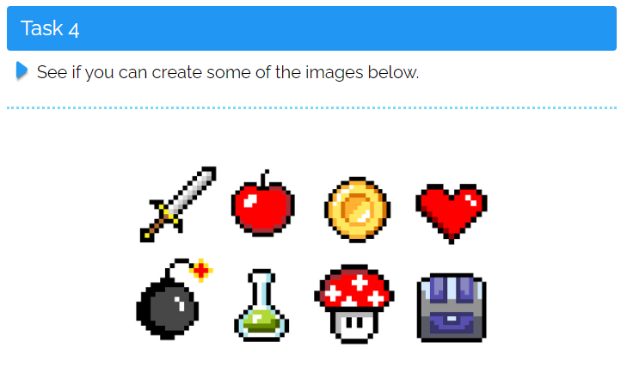
Screenshot your images Below

Slide 18
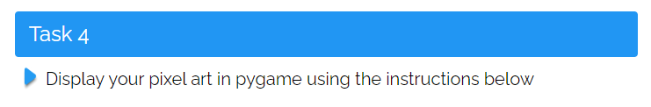
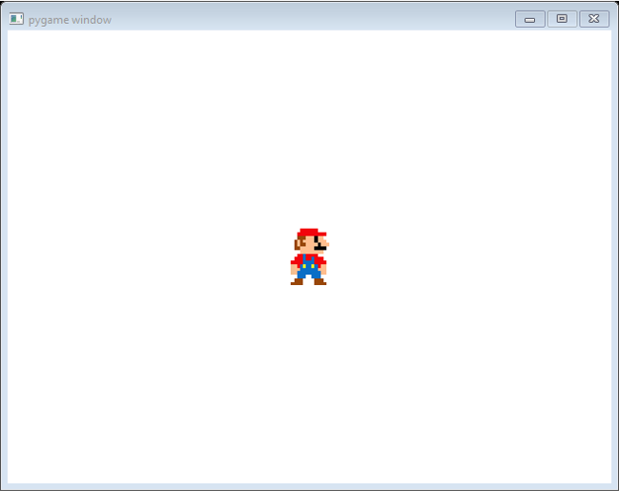
Screenshot your image Below

Slide 19
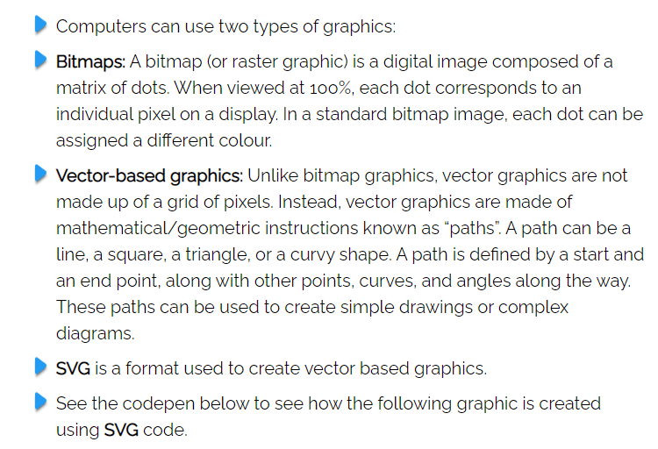
Lesson 4
Bitmaps and Vectors
I need to learn how to explain why hexadecimal is often used in computer science.
I need to learn how to explain the difference between bitmap and vector images

Slide 20
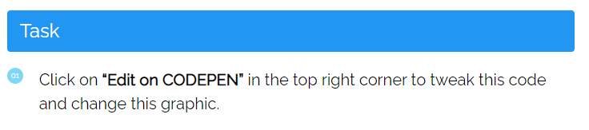
Screenshot your new image Below

Slide 21
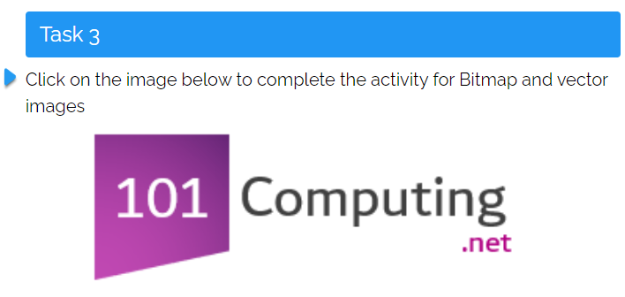
Screenshot your answers below

Slide 22
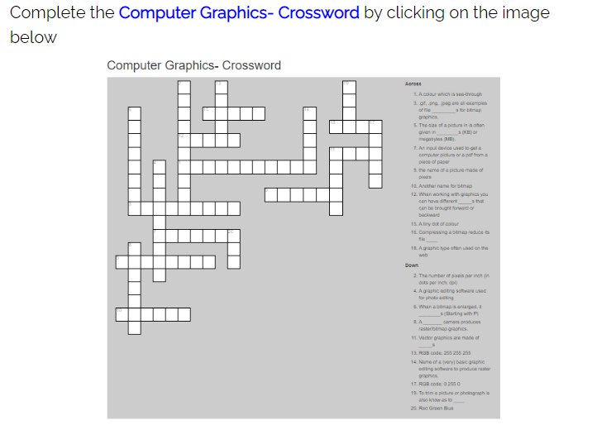
Screenshot your finished puzzle below

Slide 23
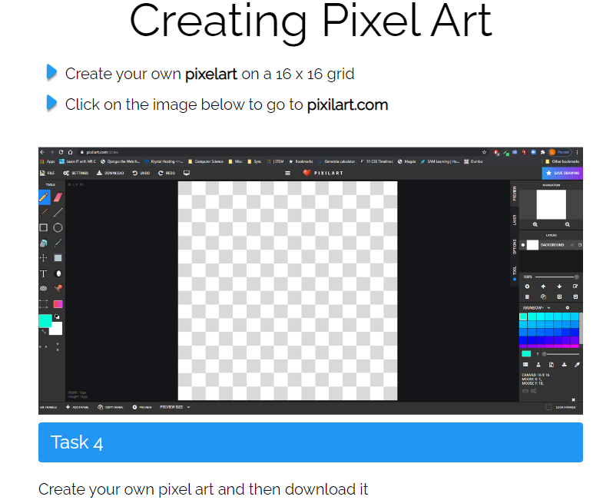
Screenshot your images Below

Slide 24
Screenshot your image Below

Slide 25
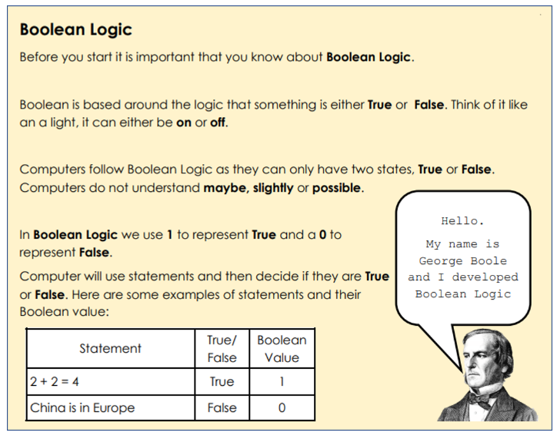
Lesson 5
Boolean Logic
I can explain what logic gates are.
I can use OR gates
I can use AND gates
I can use NOT gates

Slide 26
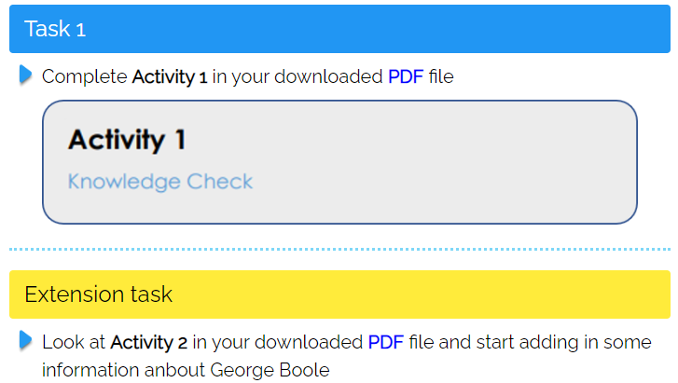
Screenshot your completed PDF pages Below

Slide 27
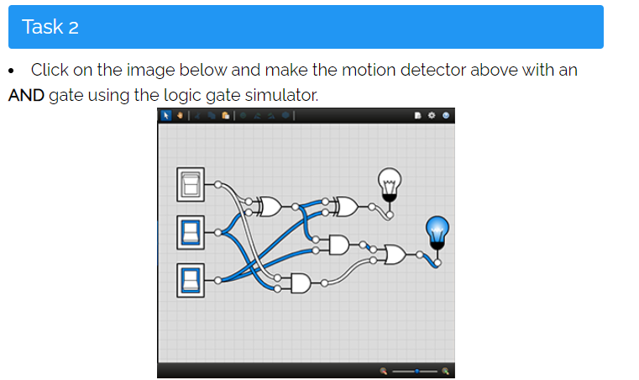
Screenshot your completed Diagram Below

Slide 28
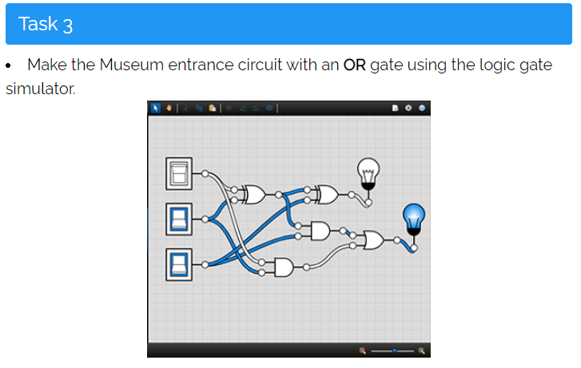
Screenshot your completed Diagram Below

Slide 29
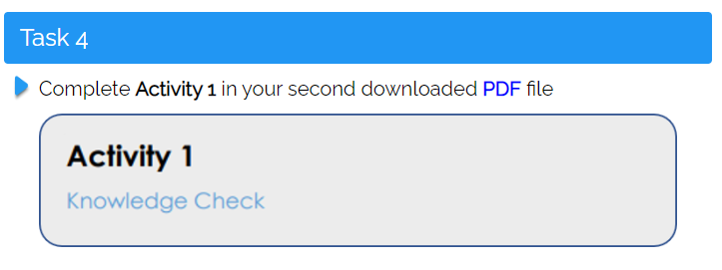
Screenshot your completed PDF pages Below

Slide 30
Screenshot your completed extension Circuits Below

Slide 31
Screenshot your completed extension Circuits Below

