Slide 1

Web Design
Put your name here
Computer Science

Slide 2
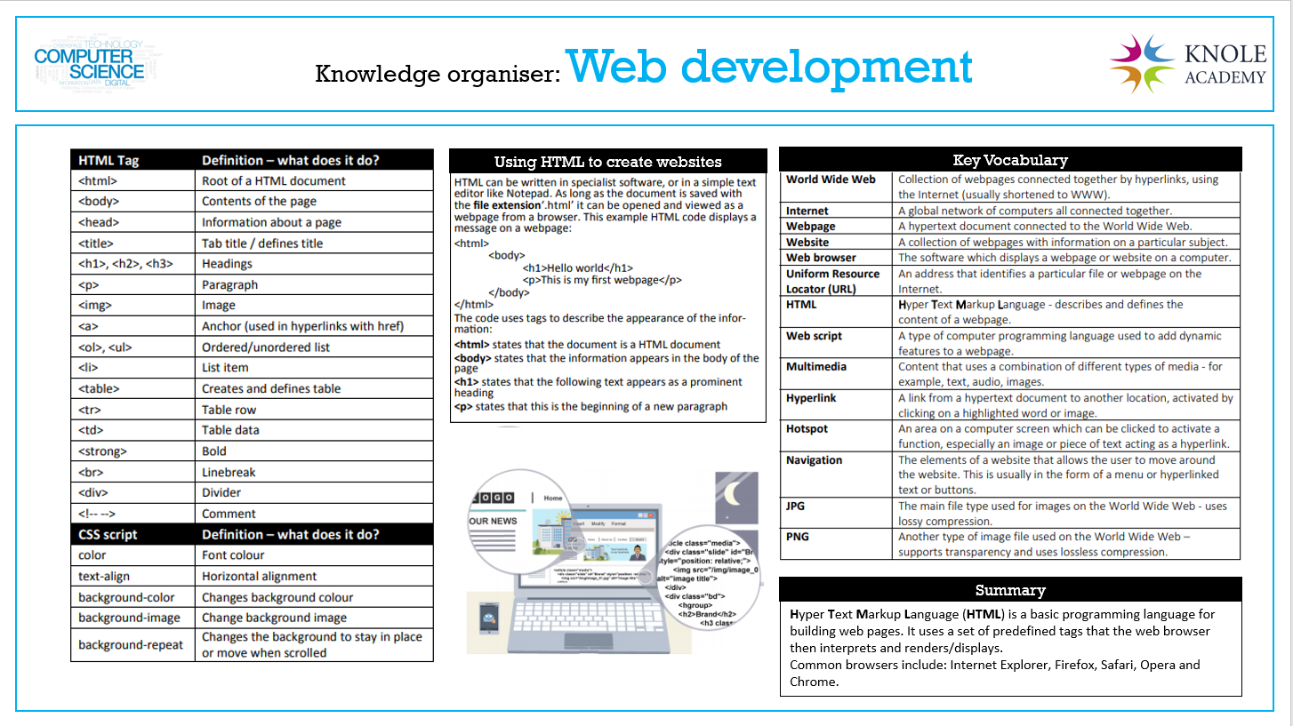

Slide 3
Lesson 1 Designing your site

Slide 4
My Screenshot

Slide 5
Lesson 2 Put lesson Name here
Put a description of the lesson here.

Slide 6
My Screenshot

Slide 7
Lesson 3 Put lesson Name here
Put a description of the lesson here.

Slide 8
My Screenshot

Slide 9
Lesson 4 Put lesson Name here
Put a description of the lesson here.

Slide 10
My Screenshot

Slide 11
Lesson 5 Put lesson Name here
Put a description of the lesson here.

Slide 12
My Screenshot

Slide 13
Lesson 6 Put lesson Name here
Put a description of the lesson here.

Slide 14
My Screenshot

