Slide 1
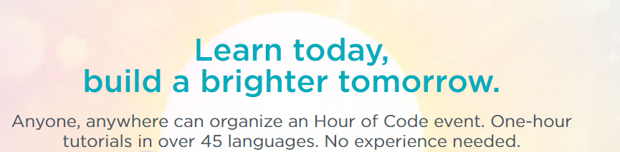

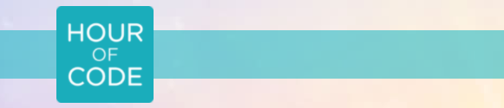
Hour of Code
Put your name here
Computer Science

Slide 2
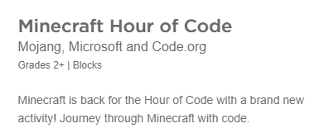

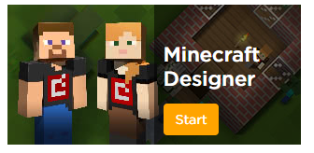
Lesson 1 Minecraft

Slide 3
My Code

Slide 4
My Code

Slide 5
Lesson 2
.

Slide 6
My Code

Slide 7
My Code

Slide 8
Lesson 3

Slide 9
My Code

Slide 10
My Code

Slide 11
Lesson 4

Slide 12
My Code

Slide 13
My Code

Slide 14
Lesson 5

Slide 15
My Code

Slide 16
My Code

Slide 17
Lesson 6

Slide 18
My Code

Slide 19
My Code

