Slide 1

Introduction to code breaking.
Year 7 Term 5

Slide 2
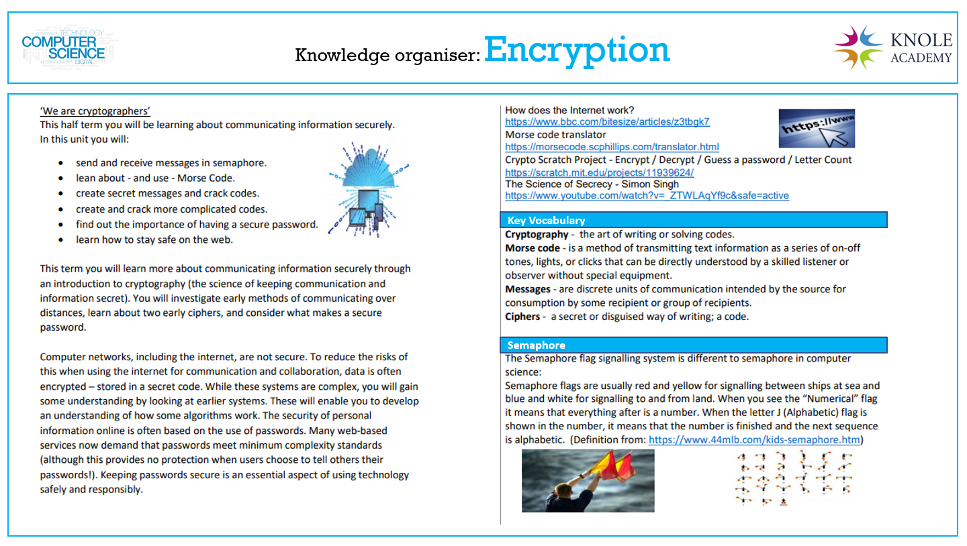

Slide 3


Targets for this lesson
I can define what encryption and decryption means.
I can describe what a cipher is.
I can decrypt messages using ciphers.
I can encrypt messages for others to decrypt.
I can evaluate the importance of code breaking.

Slide 4
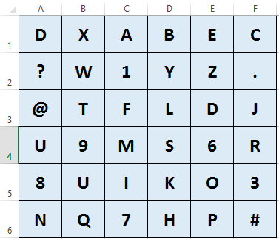
Can you decrypt the message below?
A1 C5 E3 D2 E5 A4 E1 A6 F3 E5 D2 B3 D6 E1 D3 E1 D4 D4 E5 A6 D2 E1 C1 F4 C6 A2
Write the decrypted message below:
Research and evaluate the importance of being able to decrypt messages.
_______________________________________________________________________________________________
_______________________________________________________________________________________________
_______________________________________________________________________________________________

Slide 5
Create your own message?
Write your own encrypted message below:
Why is it important to be able to encrypt messages.
_______________________________________________________________________________________________
_______________________________________________________________________________________________
_______________________________________________________________________________________________

Slide 6


Encryption and decryption
Research and define the word ENCRYPTION below.
Research and define the word DECRYPTION below.
ENCRYPTION is …?
DECRYPTION is …?

Slide 7

What is a Cipher?
Scyther !!!
Research and define the word Cipher below.
What was the Caesar Cipher?
Write your answer below:

Slide 8
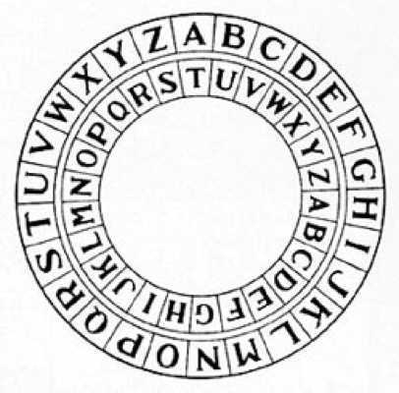
Caesar Cipher
Scyther !!!
Use this cipher wheel to decrypt my message to you below.
Encrypted message: MAX BGLBWX PAXXE XGVKRIML, MAX HNMLBWX PAXXE WXVKRIML.
(Tip - To decrypt: Look at the letters on the inside wheel first and see what letter it matches up to on the outside wheel.)
Write the decrypted message here:

Slide 9
Encrypt a message for your friend to decrypt.
(Tip – To encrypt: Look at the letters on the outside wheel first, see what letter it matches up with on the inside wheel and use that letter to encrypt the real one)
Write an encrypted message below using the cipher wheel.
Then swap with your friend so that they can decrypt it?
(Tip - To decrypt: Look at the letters on the inside wheel first and see what letter it matches up to on the outside wheel.)
Encrypted message:
_ _ _ _ _ _ _ _ _ _ _ _ _ _ _ _ _ _ _ _
Decrypted message:
_ _ _ _ _ _ _ _ _ _ _ _ _ _ _ _ _ _ _

Slide 10
Evaluation
In your own words evaluate the importance of code breaking:

Slide 11
Computing crossword
Across:
2.The father of modern computing. (First and last name).
4.She made the first algorithm. (last name only).
8.The founder of Apple. (last name).
9.The founder of Microsoft. (last name only).
11.Solving the message that you have received.
Down:
1.The father of the computer. (last name only).
3.Someone who breaks codes.
5.A set of steps to solve a problem.
6.A machine that was used to encrypt messages in WW2.
7.The code for a secure website.
10.Hiding a message that you want to send.
 |  |  |  |  | 1)
 |  |  | 2)
 |  |  | 3)
 |  | 4) |  |  |  |  | 5) |  | 6)
 |  |  |  |  |  |  |  |  |  |  | 7)
 | 8) |  |  |  |  |  |  |  | 9)
 |  |  |  |  | 10)
11)

