Slide 1


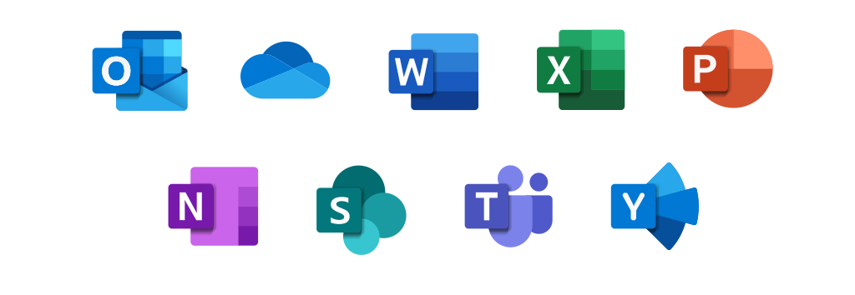
Learning Journal
Unit 1:E-Skills

Slide 2

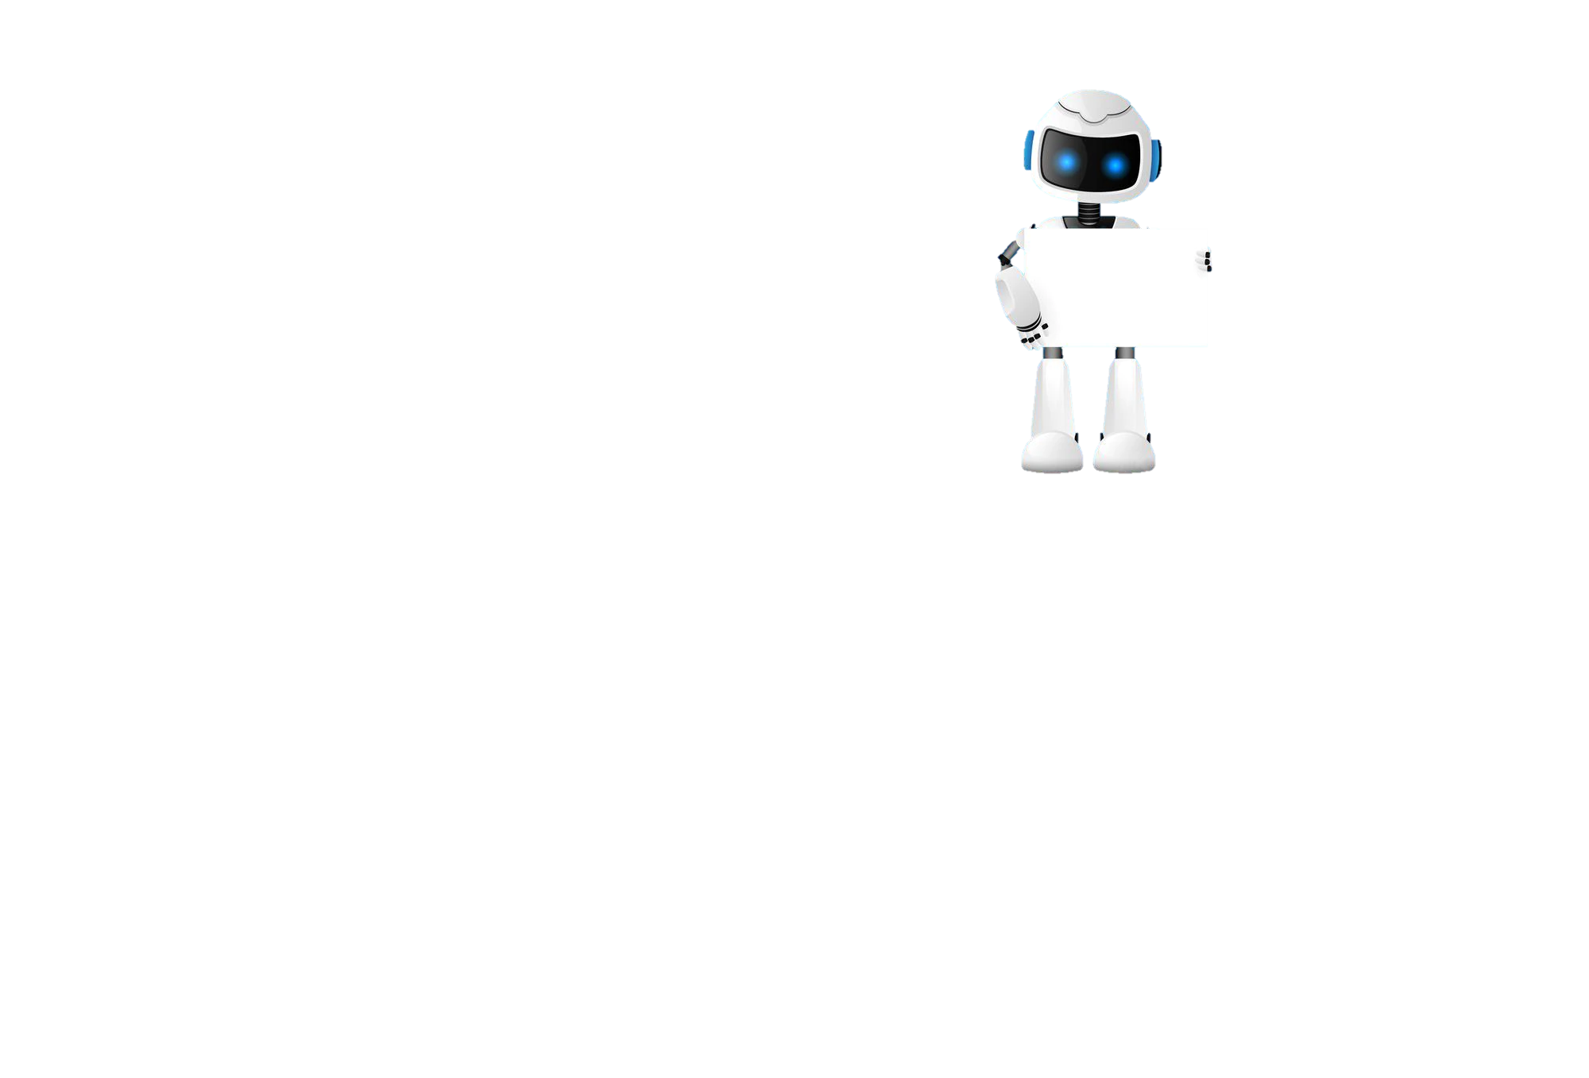
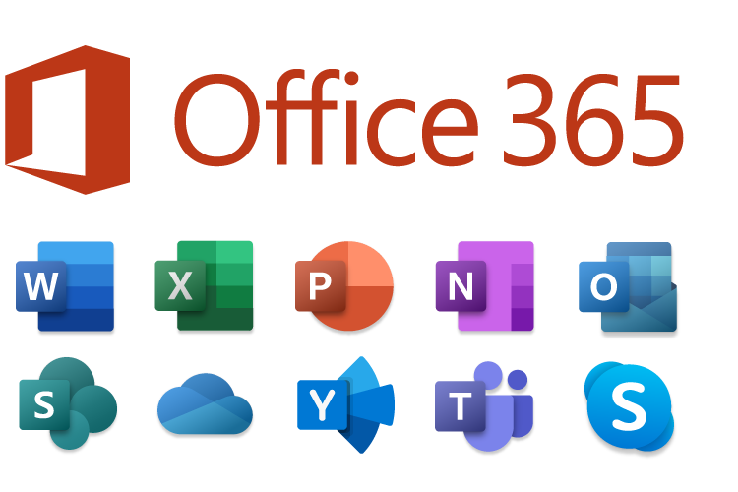

Lesson 2
Task 1 – Getting Started
Learning Objectives
Start
I can access and use office 365 on my computer
I can access email online and send an email to a teacher
I can save work using the cloud
Learn

Slide 3
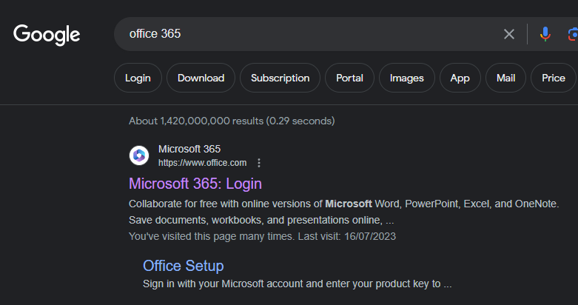

I can use Outlook to send an email
Lesson 2
Task 2 – Logging onto Office 365
1
2
Click link
Put a screen capture of your Office 365 inside this box

Slide 4
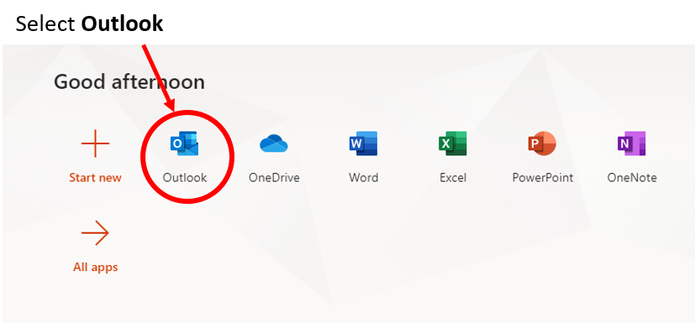
I can use Outlook to send an email
Lesson 2
Task 3 – Using Outlook
Put a screen capture of the email you sent here.

Slide 5
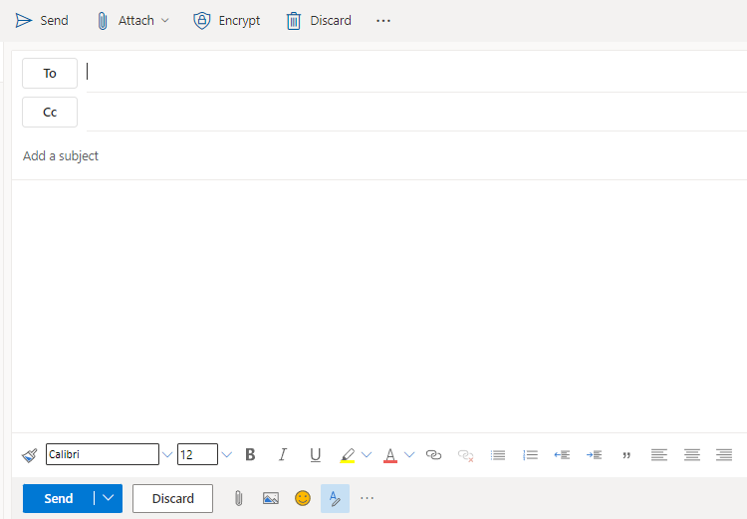
I can use Outlook to send an email
Lesson 2
Task 4 – Using Cc
Put the name of the person you want to Cc into the email on the Cc line.
Put a screen capture of the email you sent using Cc here.

Slide 6
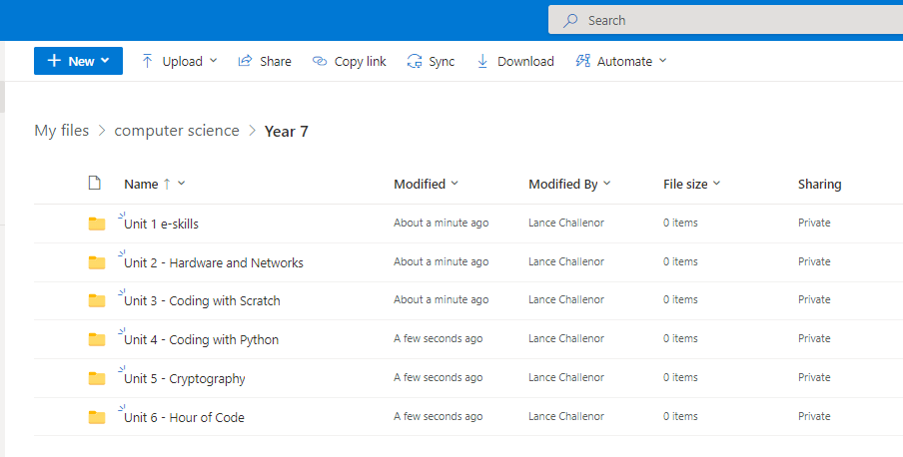
I can create and organise folders using OneDrive
Lesson 2
Task 5 – Using OneDrive
Put a screen capture of your OneDrive folders inside this box

Slide 7
I can create a document and save it in my e-skills folder
Lesson 2
Task 6 – Extension
Put a screen capture of your saved Test File in here.

Slide 8

Lesson 2
Task 7 – Lesson review
How did you do?
Learning Objectives
Complete
I can access and use office 365 on my computer
I can access email online and send an email to a teacher
I can save work using the cloud
Reflect
Write what you have learned today in the box below and anything you are still unsure of.

Slide 9

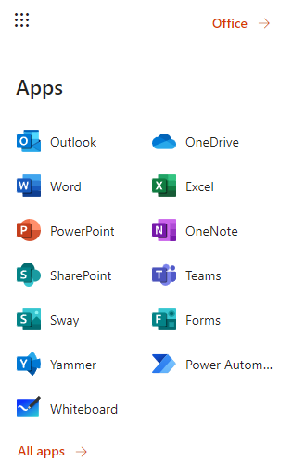
Homework
Task 8 – House Point Homework
Homework task
Open a new PowerPoint
Create a colourful title page for it
Save your PowerPoint in your e-skills folder in OneDrive
Call it e-safety

